Slide 1
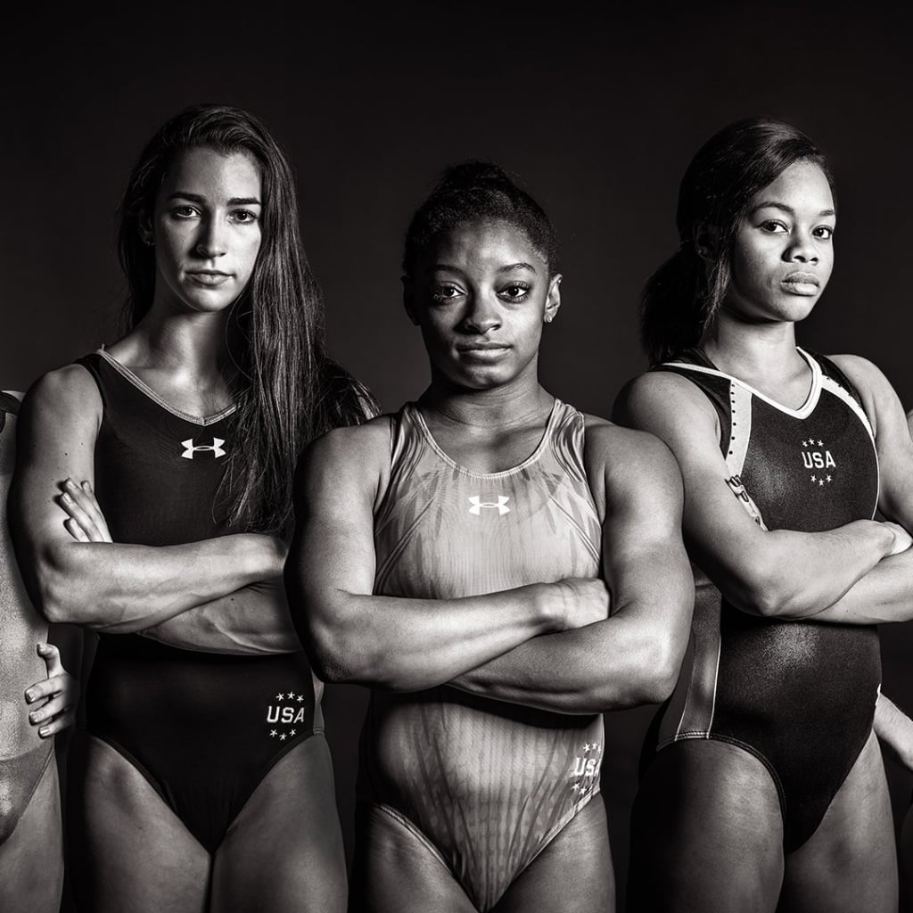
Women & the Olympic Games
By Alexander Espinosa, Ashley Lutz, Celenia Chapa, Felecia Helms, and Tyler Cutrer

Slide 2

Agenda
Team
Overview
Data
Exploration
Analysis

Slide 3





Git Sum
Alex Espinosa
Tyler Cutrer
Celenia Chapa
Ashley Lutz
Felecia Helms

Slide 4

Overview
Data Source

Slide 5
Questions
Did Women’s participation in the Olympic Games change over the years?
Which sports had the biggest increase in Women participation in relation to the women’s movement?
What is the average age of a Female Olympian and does this average age change depending on country?
Did world events affect the performance of Olympic Athletes?

Slide 6
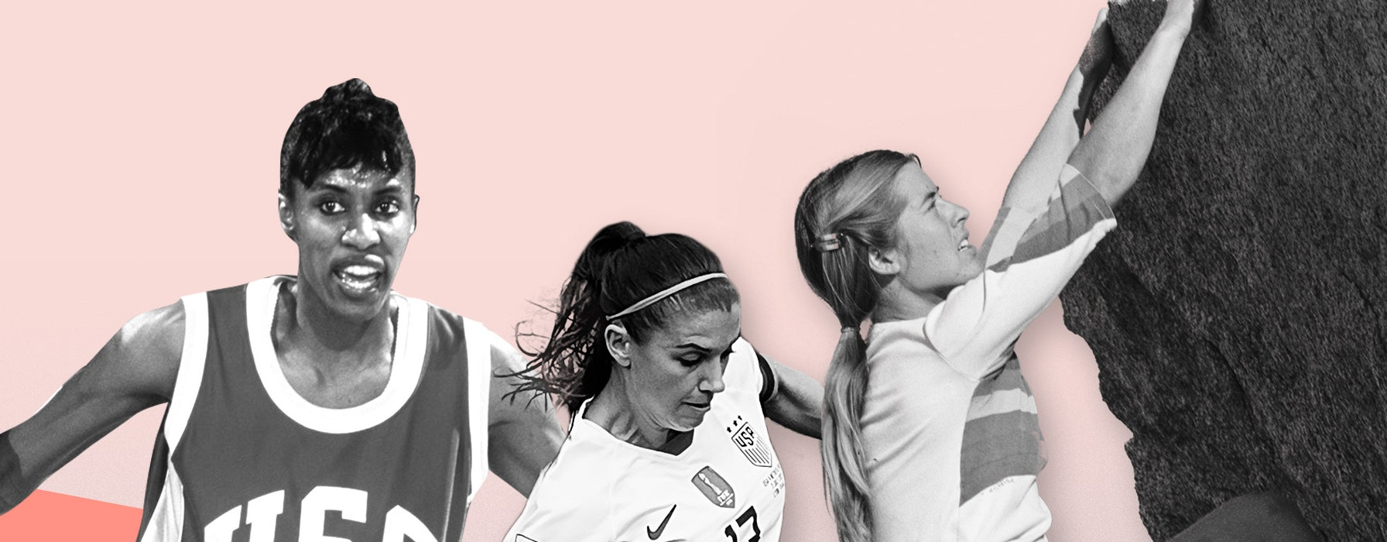
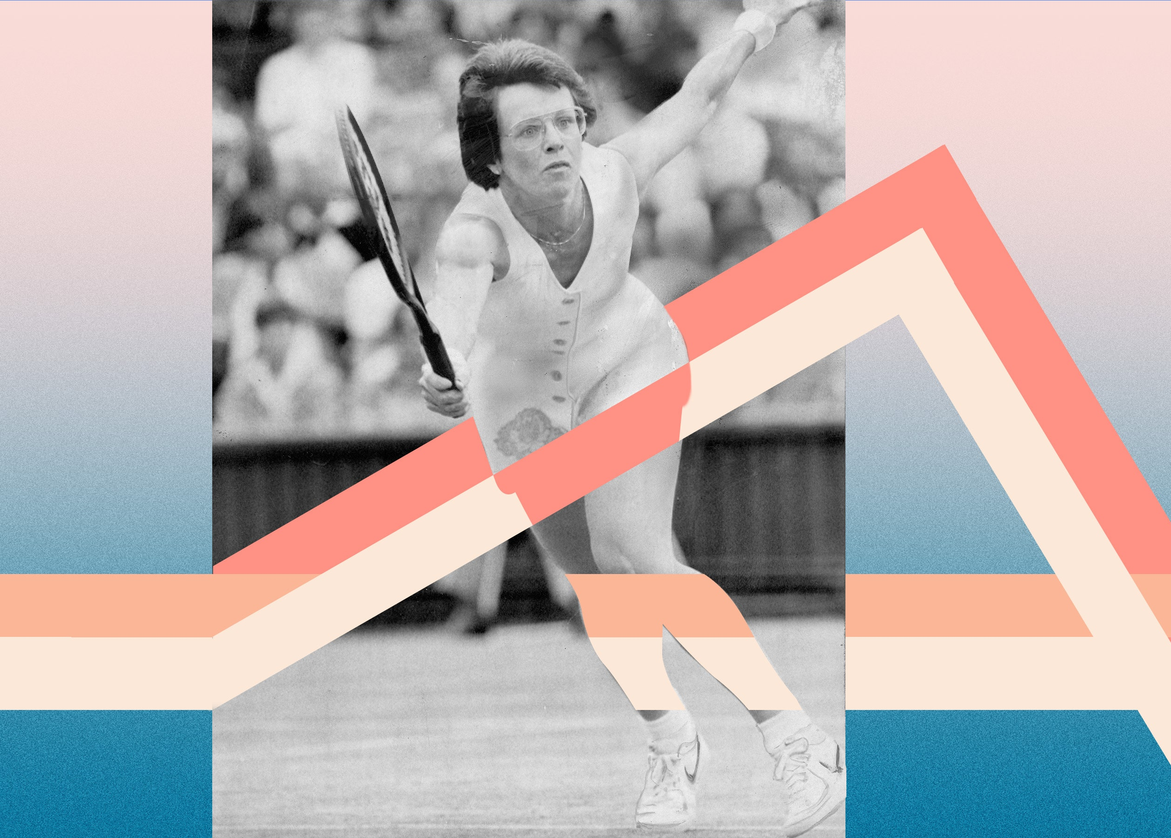
Women’s Suffrage
Historically, women are underpaid, undervalued, and overlooked at every turn. But they’re fighting back—and winning.

Slide 7
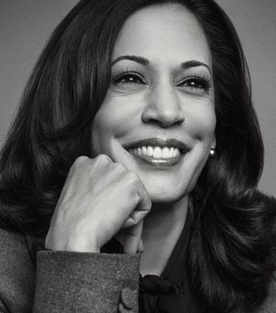
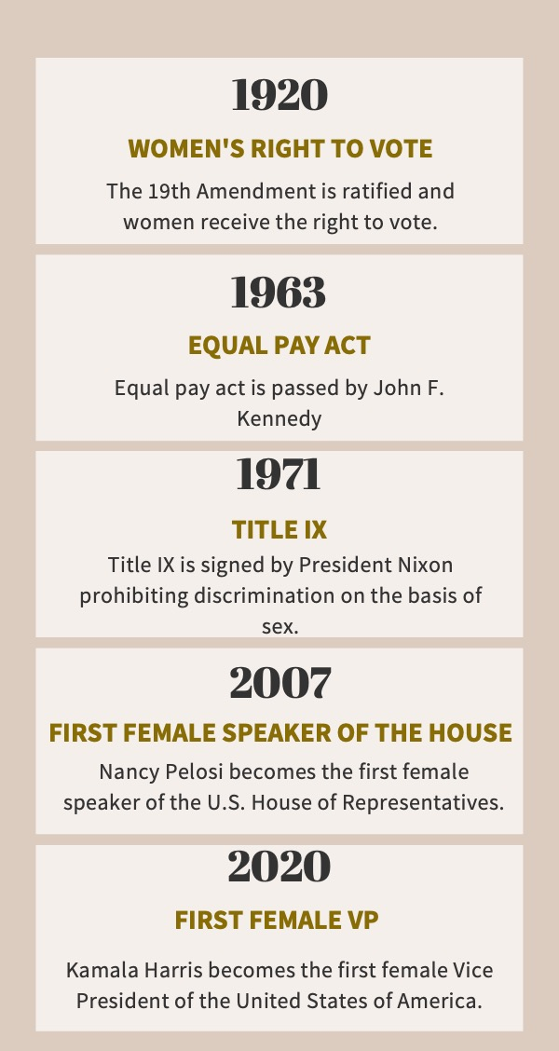
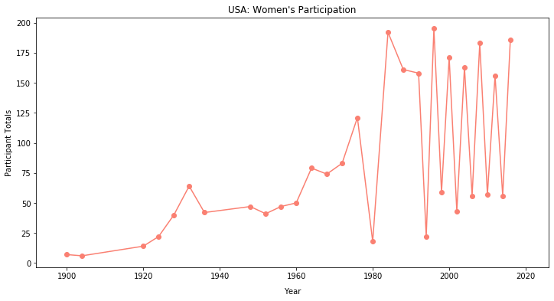
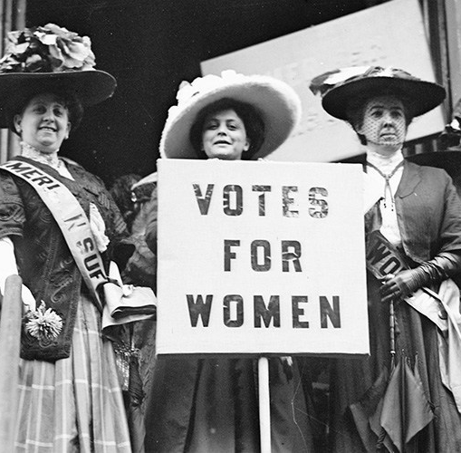
Women’s Suffrage

Slide 8
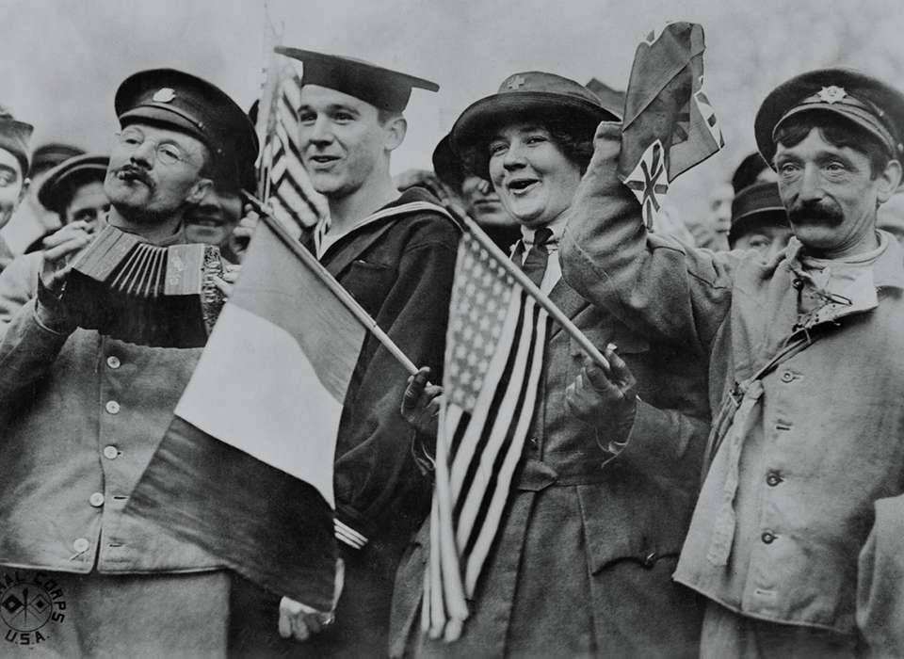
World Events
WWII: 1939-1945
Boycott: 1980s

Slide 9
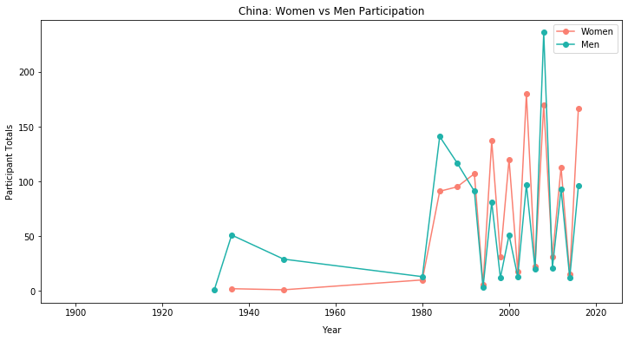
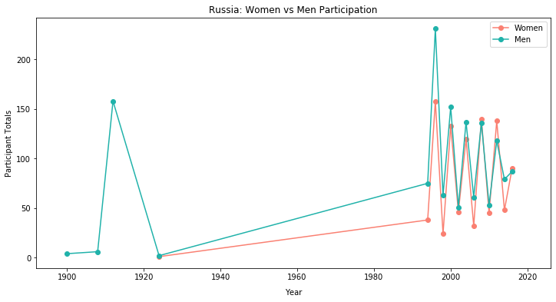
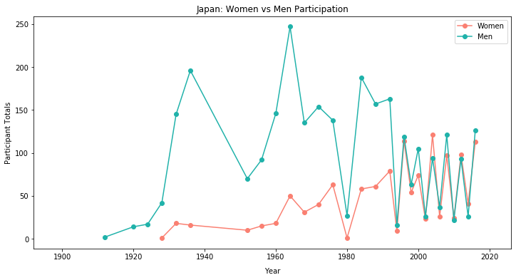
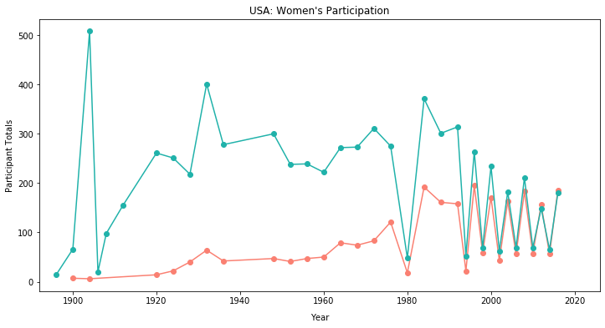
World Participation
China
Russia
Japan
USA

Slide 10
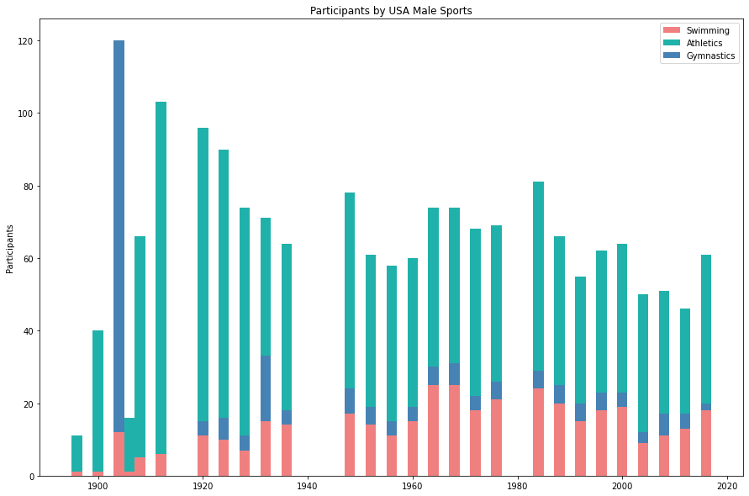
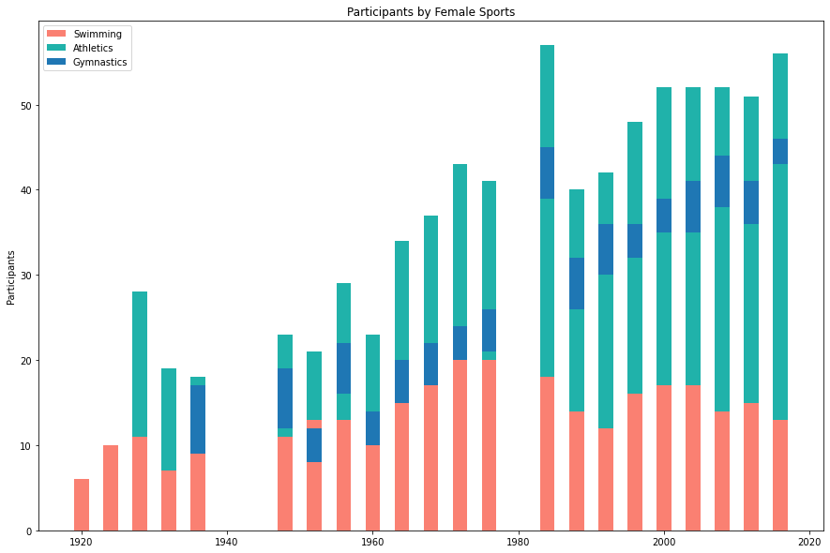
Participation by Sport

Slide 11
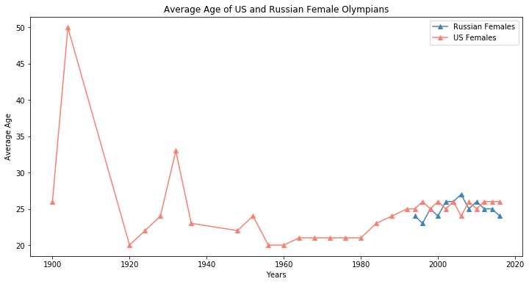
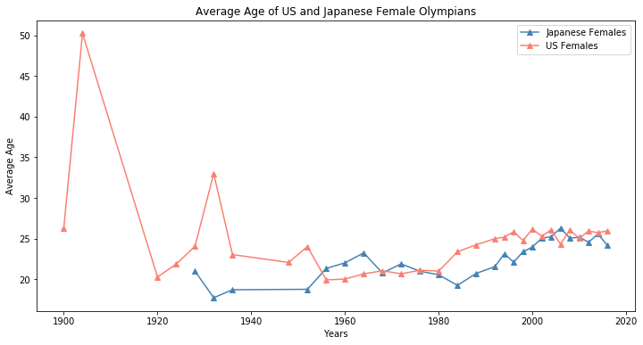
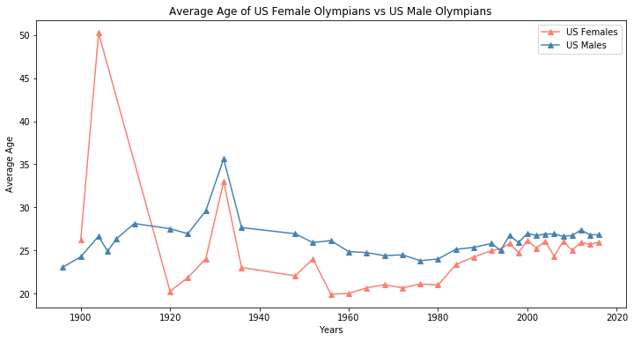
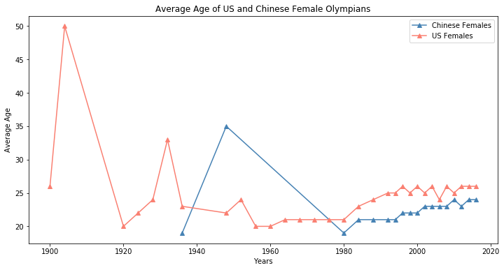
Age Analysis

Slide 12
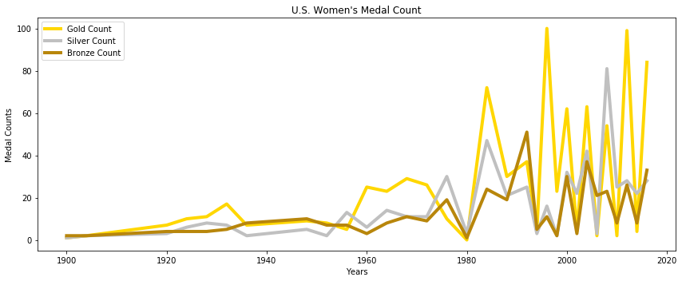
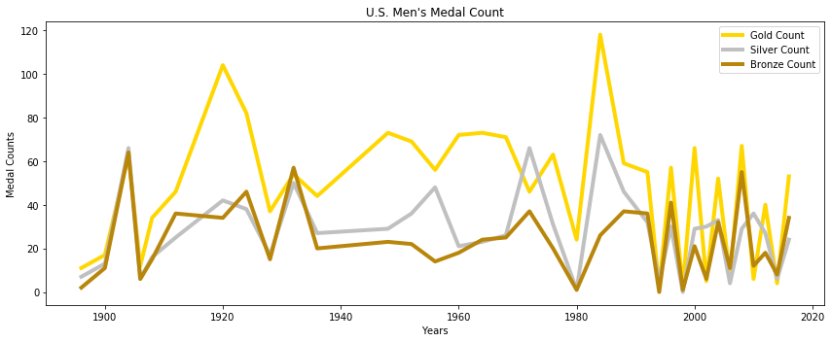
U.S. Medal Count

Slide 13
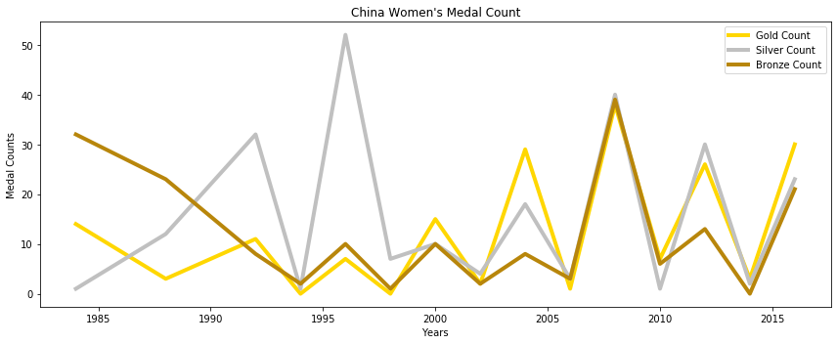
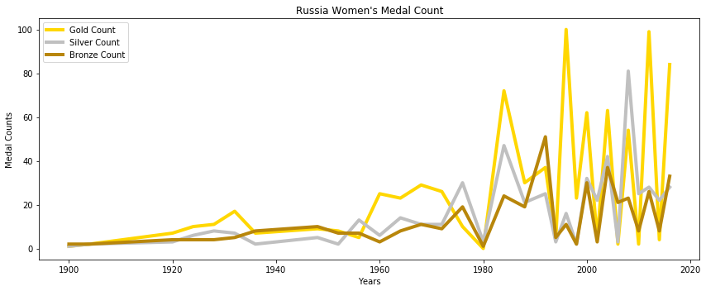
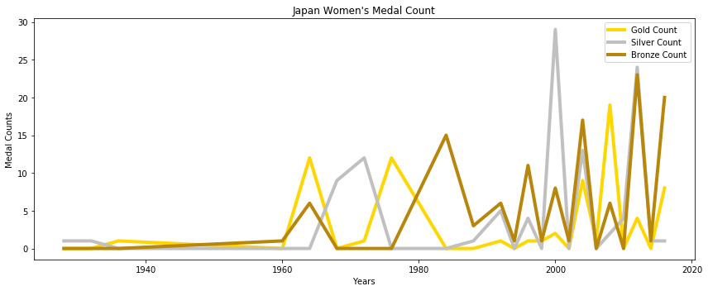
World Medal Count

Slide 15
References

